Slide 1


Desktop-Based Quiz Management System
PRESENTED BY
Niravbhai Savaliya
Yashkumar Sarena
July 27, 2026

Slide 2







Desktop-Based Quiz Management System
This presentation explores the development and implementation of a Desktop-Based Quiz Management System, designed to enhance educational assessments through an interactive JavaFX application. We will cover its architecture, features, and future potential in academic environments.

Slide 3


Identifying the Need for a Quiz Management System
Time-Consuming Manual Processes
Demand for Efficient Assessment Tools
Traditional quiz management involves extensive manual effort, leading to inefficiencies and increased chances of errors.
Educational institutions require streamlined tools for assessments to enhance learning outcomes and save time.
Lack of Centralized Solutions
Current systems often lack integration, making it difficult to manage quizzes across different platforms effectively.

Slide 4
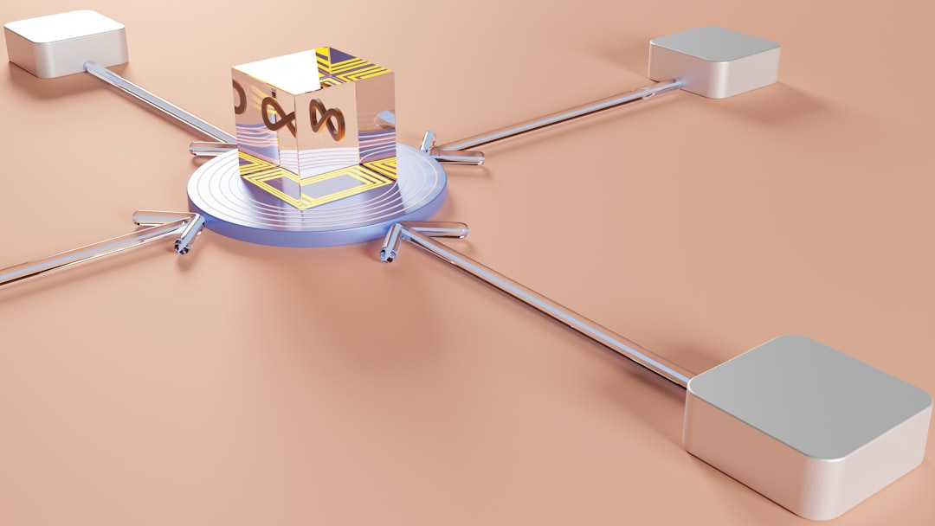


Technology Stack Overview
Java and JavaFX
JDBC for Connectivity
MySQL Database Management
Java provides a robust platform, while JavaFX enhances UI with rich graphics and animations.
JDBC enables seamless communication between the Java application and MySQL database for data operations.
MySQL offers reliable data storage, supporting complex queries and transactions for efficient data handling.

Slide 5
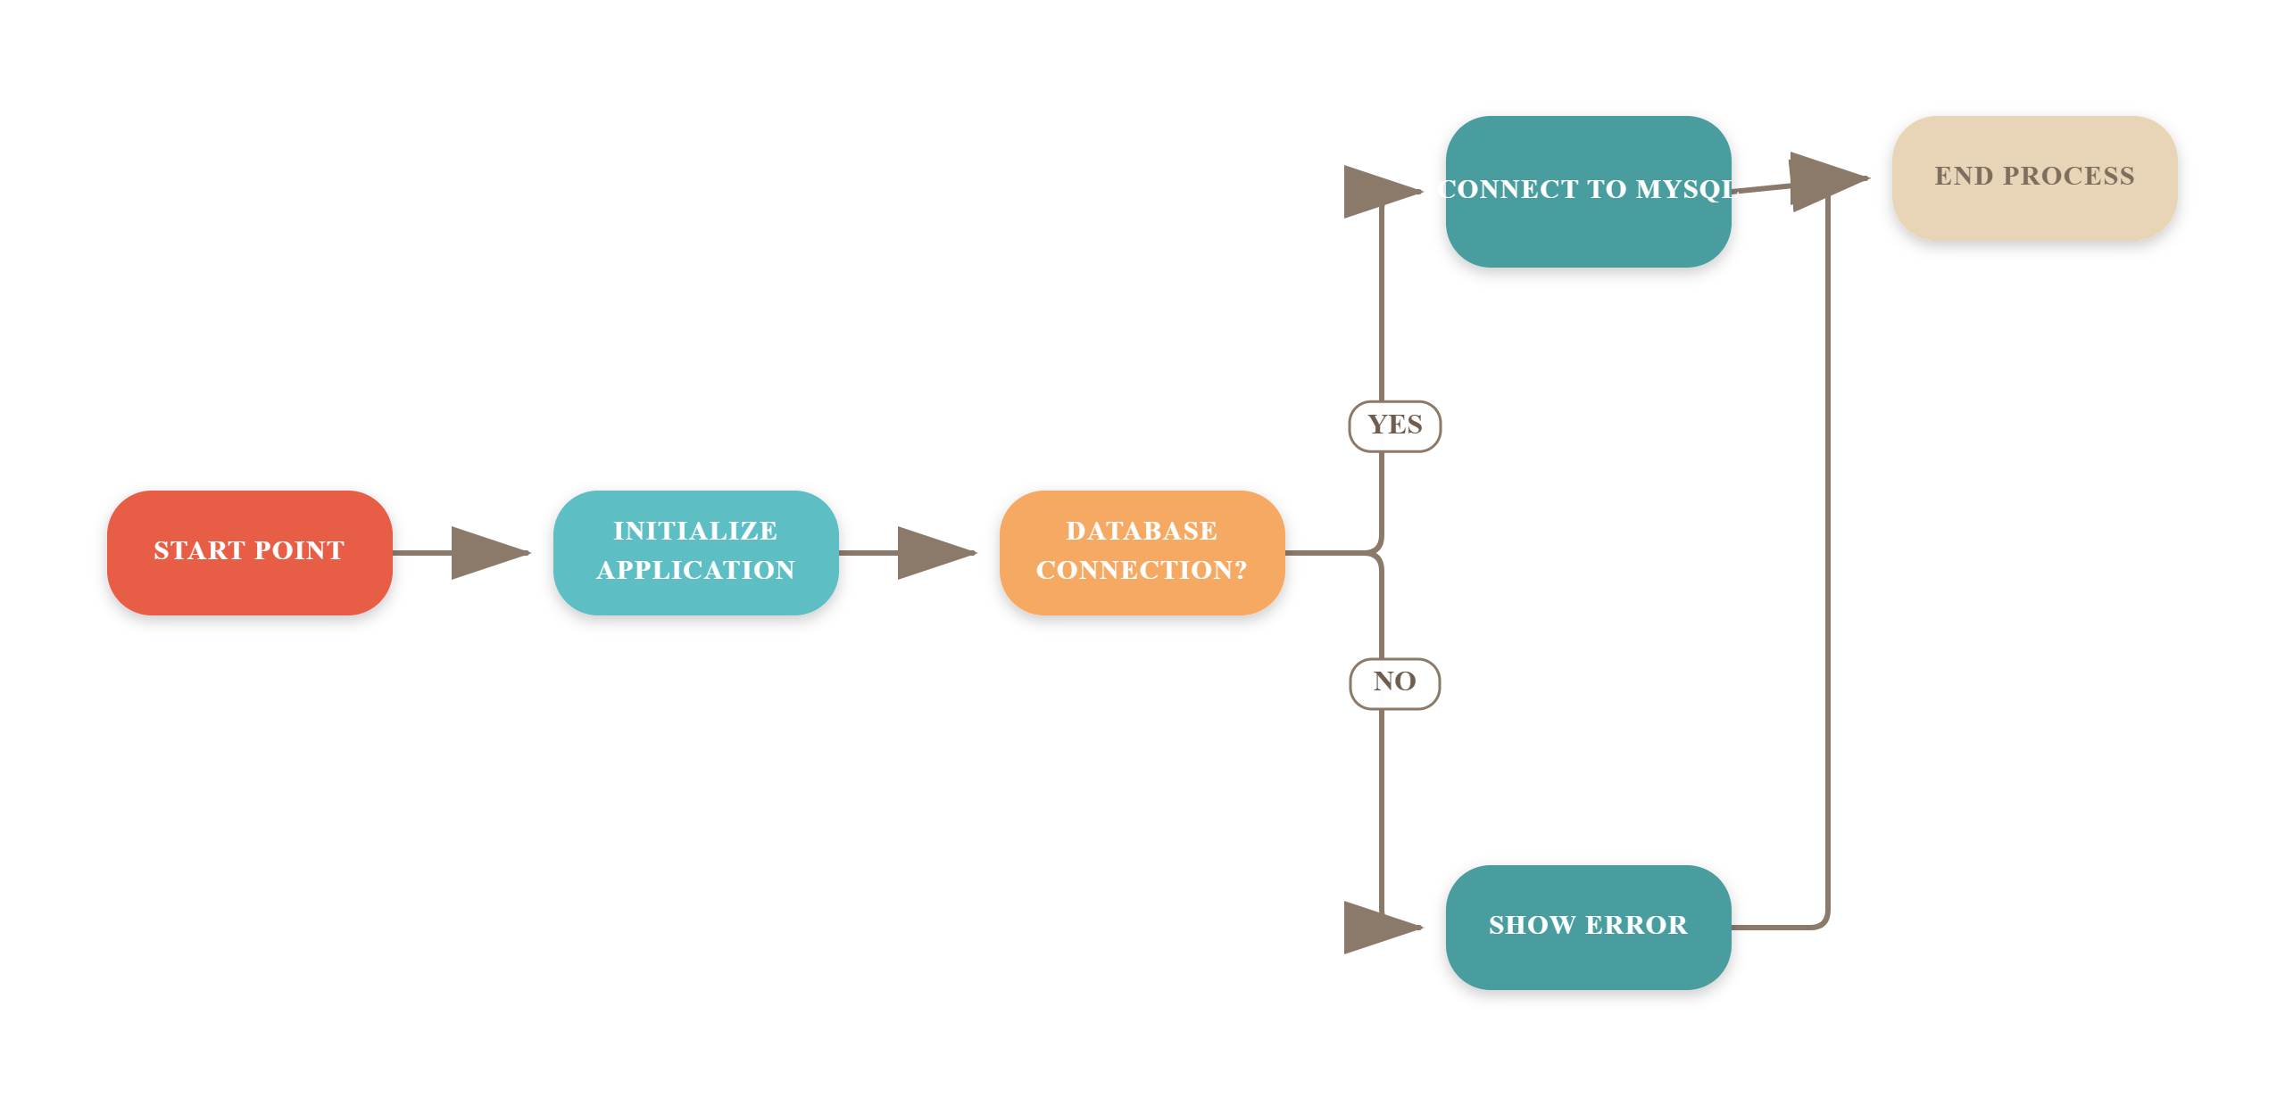
System Architecture Overview

Slide 6










Key Features
User-Friendly Interface
Real-Time Analytics
Secure Authentication
Designed for easy navigation, ensuring a seamless user experience.
Provides instant quiz results and analytics for informed decision-making.
Ensures user data protection with robust authentication mechanisms.
Multi-User Support
Centralized Database
Customizable Settings
Allows multiple users to participate and manage quizzes simultaneously.
Utilizes MySQL for efficient data management and storage.
Offers various settings to tailor the quiz experience to user needs.

Slide 7
Conclusion
Streamlined Quiz Management
Enhanced Learning Efficiency
The system automates quiz creation, distribution, and grading, saving educators significant time and effort.
Students receive immediate feedback, improving their learning outcomes and engagement with the material.
Future Mobile Integration
Plans for mobile app integration will expand accessibility, allowing quizzes to be taken anytime, anywhere.

Slide 8
Continuing the Presentation Flow
Implementation Strategies
User Experience Enhancements
Discussing the phased approach for deploying the Quiz Management System effectively.
Highlighting features that improve usability and engagement for both educators and students.
Impact on Educational Outcomes
Analyzing how streamlined quiz management can boost learning efficiency and assessment accuracy.

Slide 9
Continuing the Presentation Flow
1
User Requirements Analysis
Identify key user needs to tailor the system effectively.
2
System Functionalities Overview
Discuss essential features that enhance user experience and efficiency.
3
Implementation Strategies
Outline steps for successful deployment and integration into existing workflows.
4
Feedback Mechanisms
Establish channels for user feedback to drive continuous improvement.
5
Future Enhancements
Explore potential upgrades and features based on user feedback and trends.

Slide 10

Questions & Answers
How to Submit Questions: 1. Scan the QR code
2.
Enter your question
3.
Submit anonymously

